Slide 1
CATCH-U-DNA General Meeting 1st – 2nd December 2018, Madrid, Spain

Slide 2
WP1. Acoustic wave devices and measurement control unit
Objectives and current results

Slide 3
Outline
Objectives
Main achievements
Future plans
List of deviations, delays or other problems
Questions

Slide 4
1. Objectives
Chip containing an array of TSBAR sensors
Measurement system

Slide 5
1. Objectives
Workpackage structure
SENSOR DESIGN AND MODELING
Task 1.1 (M1-M15)
SENSOR FABRICATION
Task 1.2 (M4-M18)
MEASURING TECHNIQUE
Task 1.3 (M1-M12)

Slide 6
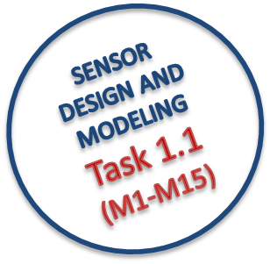
2. Main achievements
Sensor Numerical Models
Analysis performed
Modal
Harmonic
Harmonic (considering damping)
Parametric
Main Conclusions
It is possible to change ZnO substrate deposition angle to obtain a S-FBAR to be used in liquids
Surface Acceleration (sensitivity) is higher in HFFQCM (@150 MHz) than in S-FBAR (2GHz)
Interferences in HFFQCM arrays are lower than 50 dB when spacing 1.7 mm

Slide 7
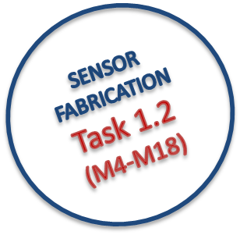
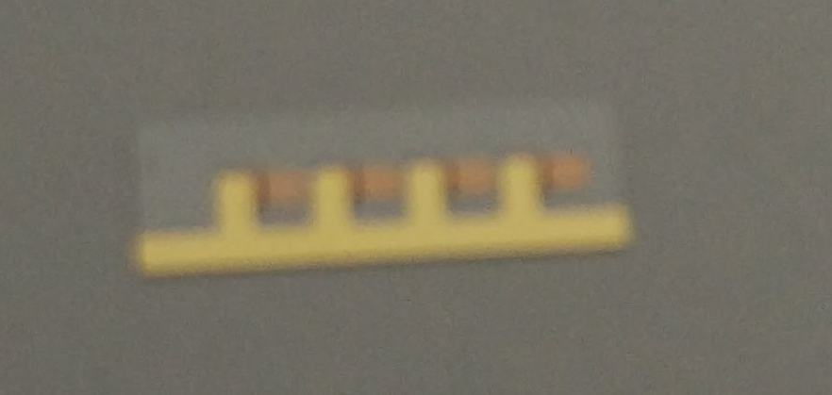
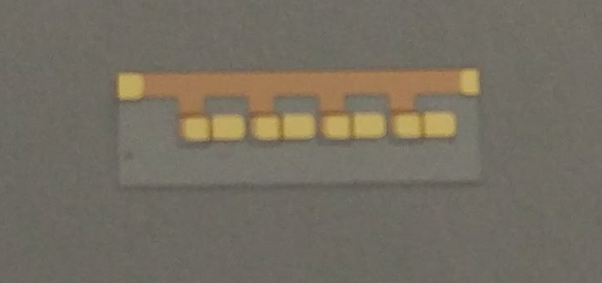
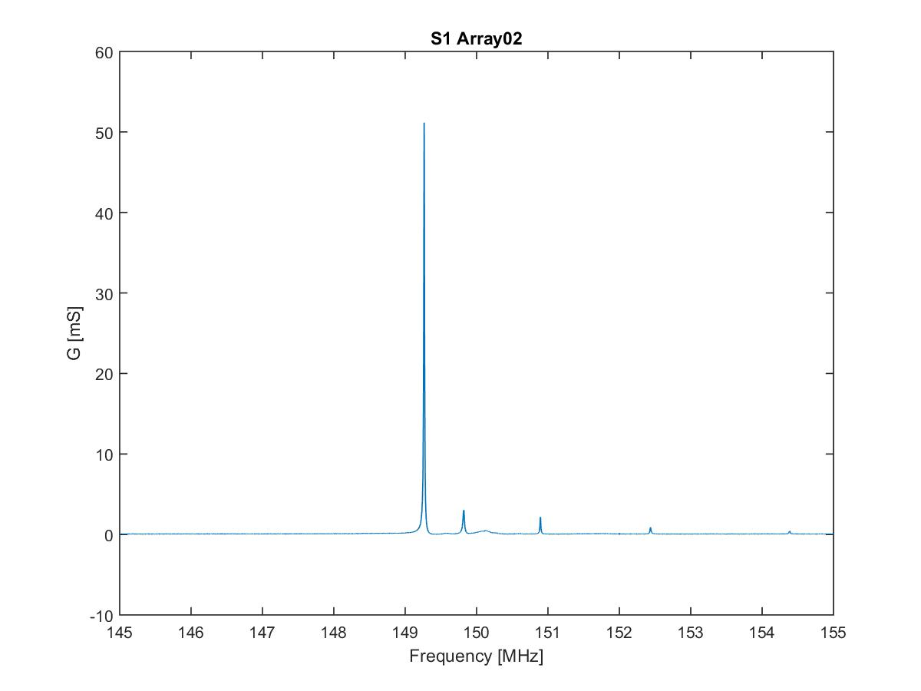
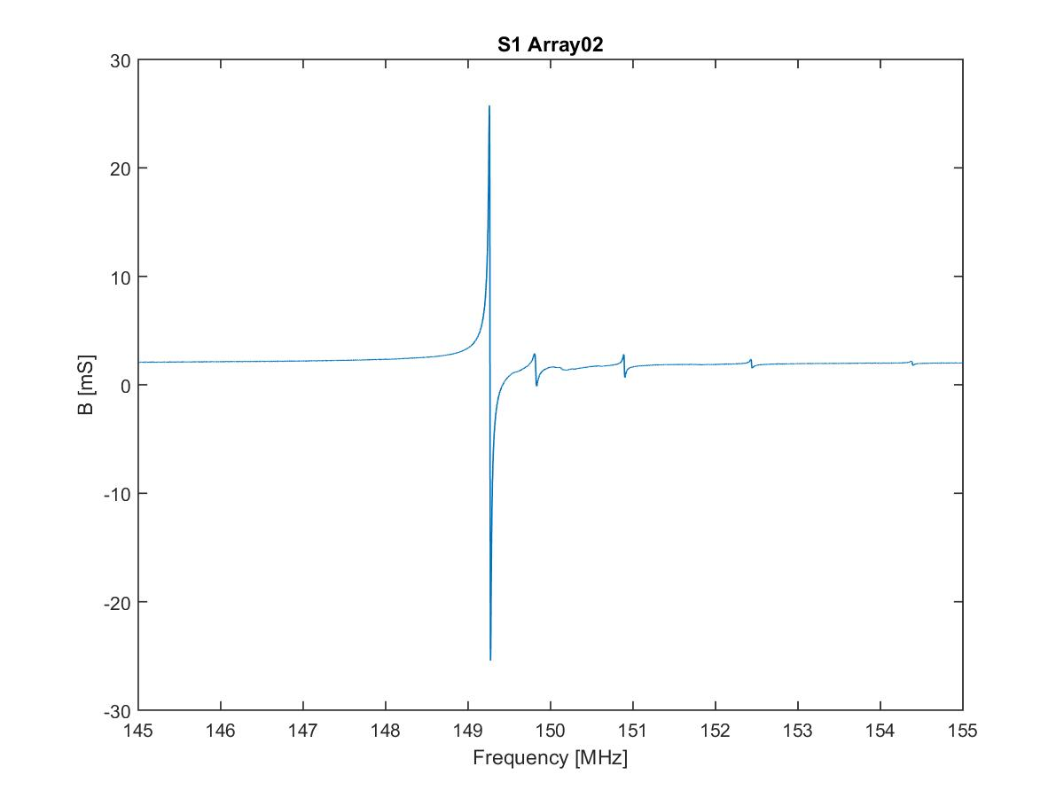
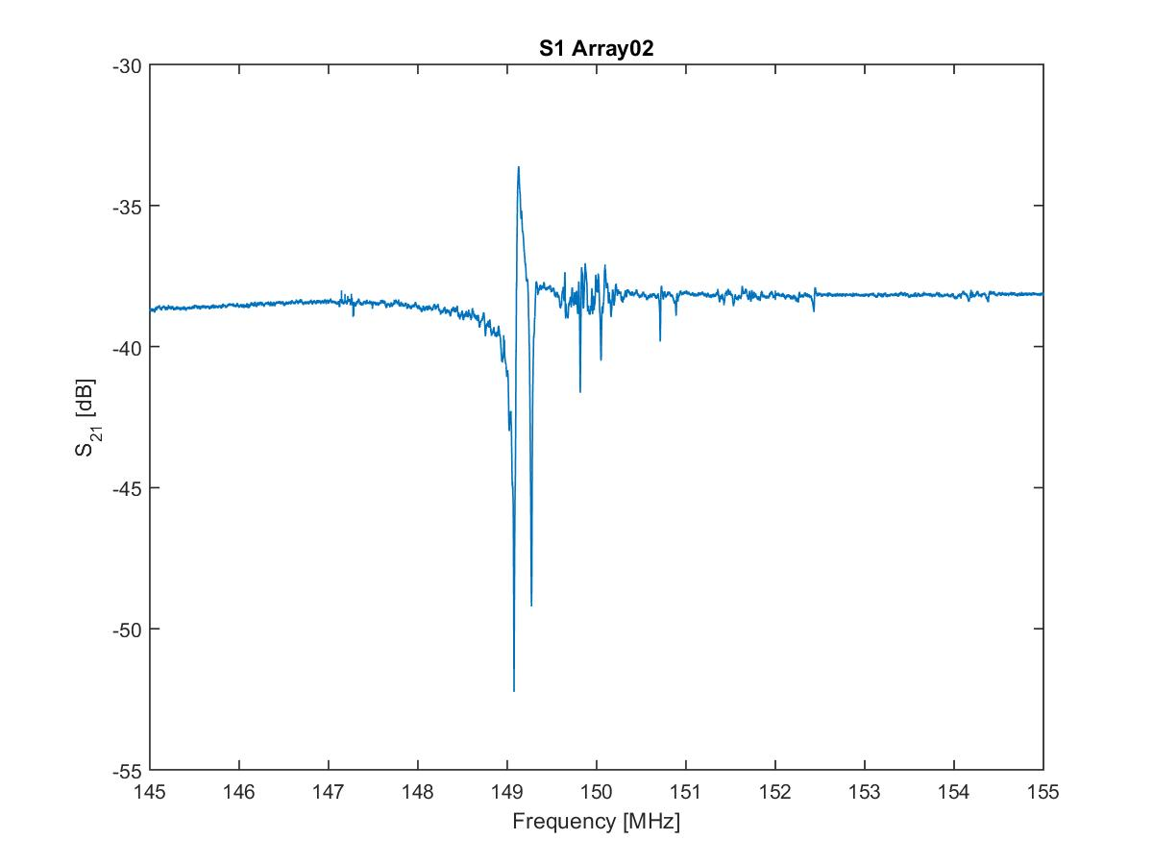
2. Main achievements
4 sensor HFFQCM array
Characterized
Top
@ 150 MHz
AT-cut quartz substrate
Cr/Au electrodes (5 nm/ 67 nm)
Bottom

Slide 8
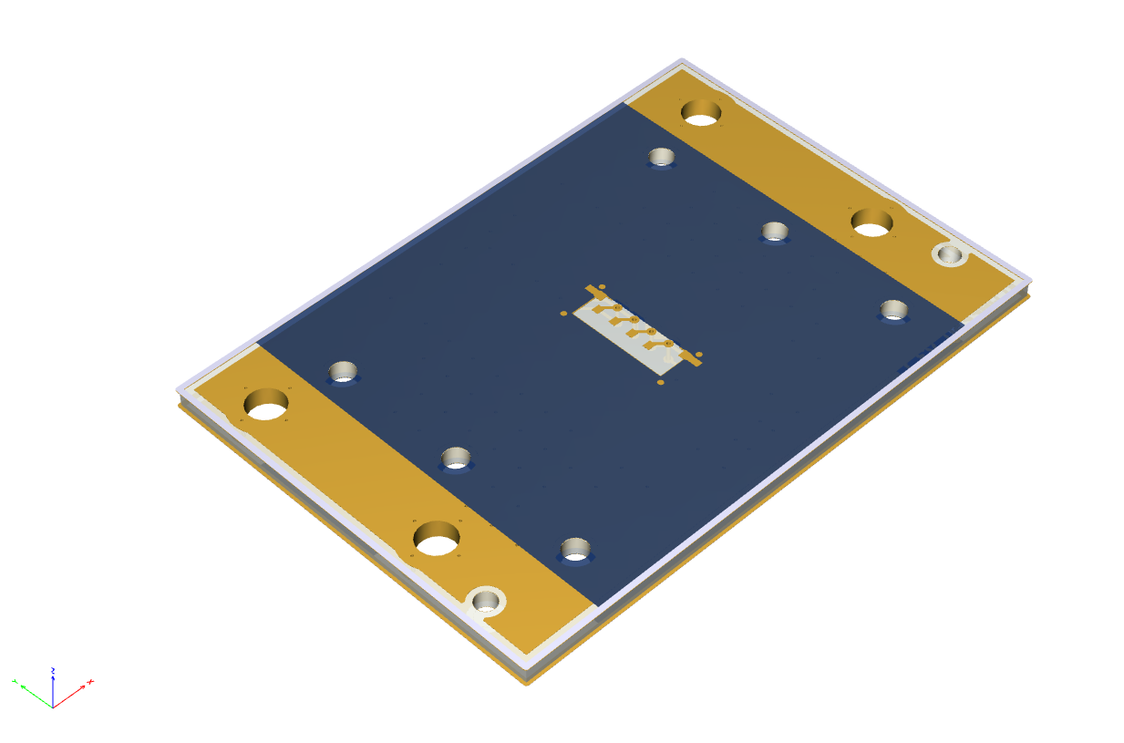
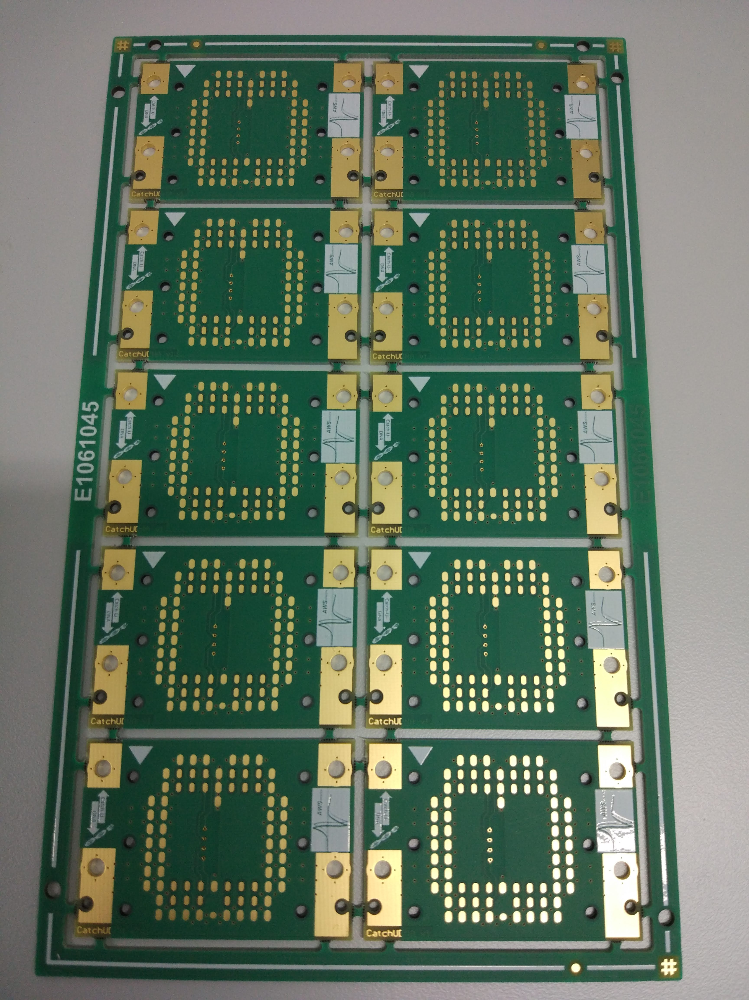
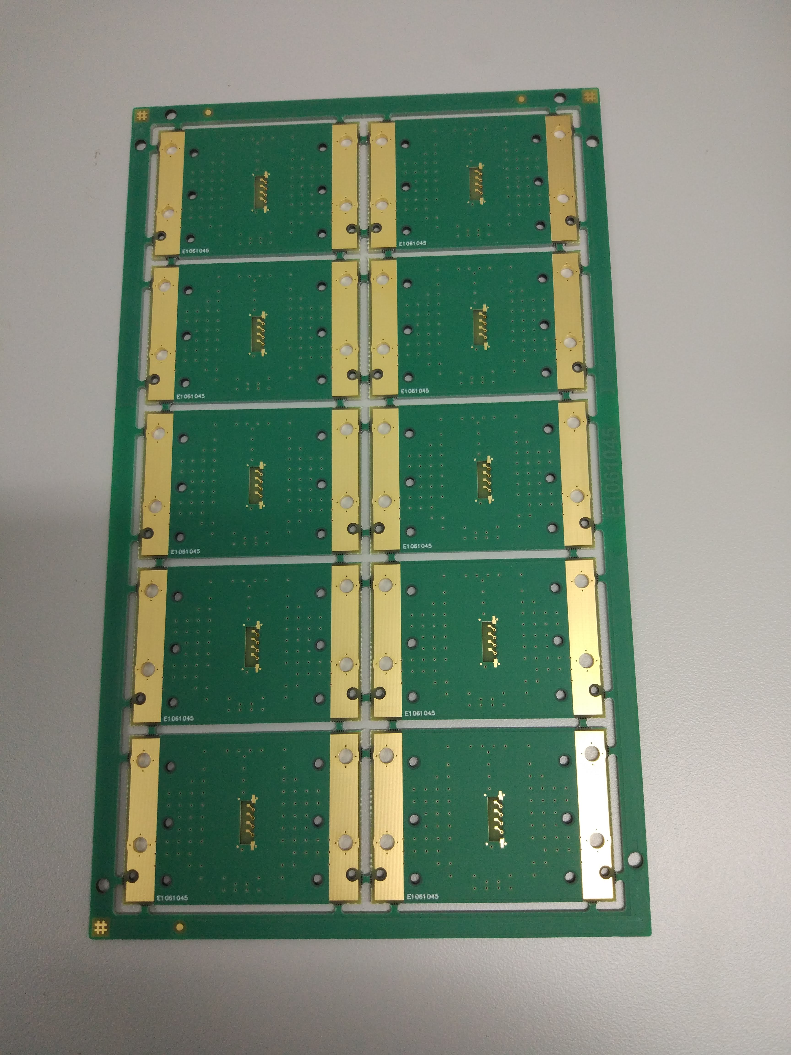
2. Main achievements
4 sensor HFFQCM array PCB
Implemented
Panel Bottom
Panel Top

Slide 9
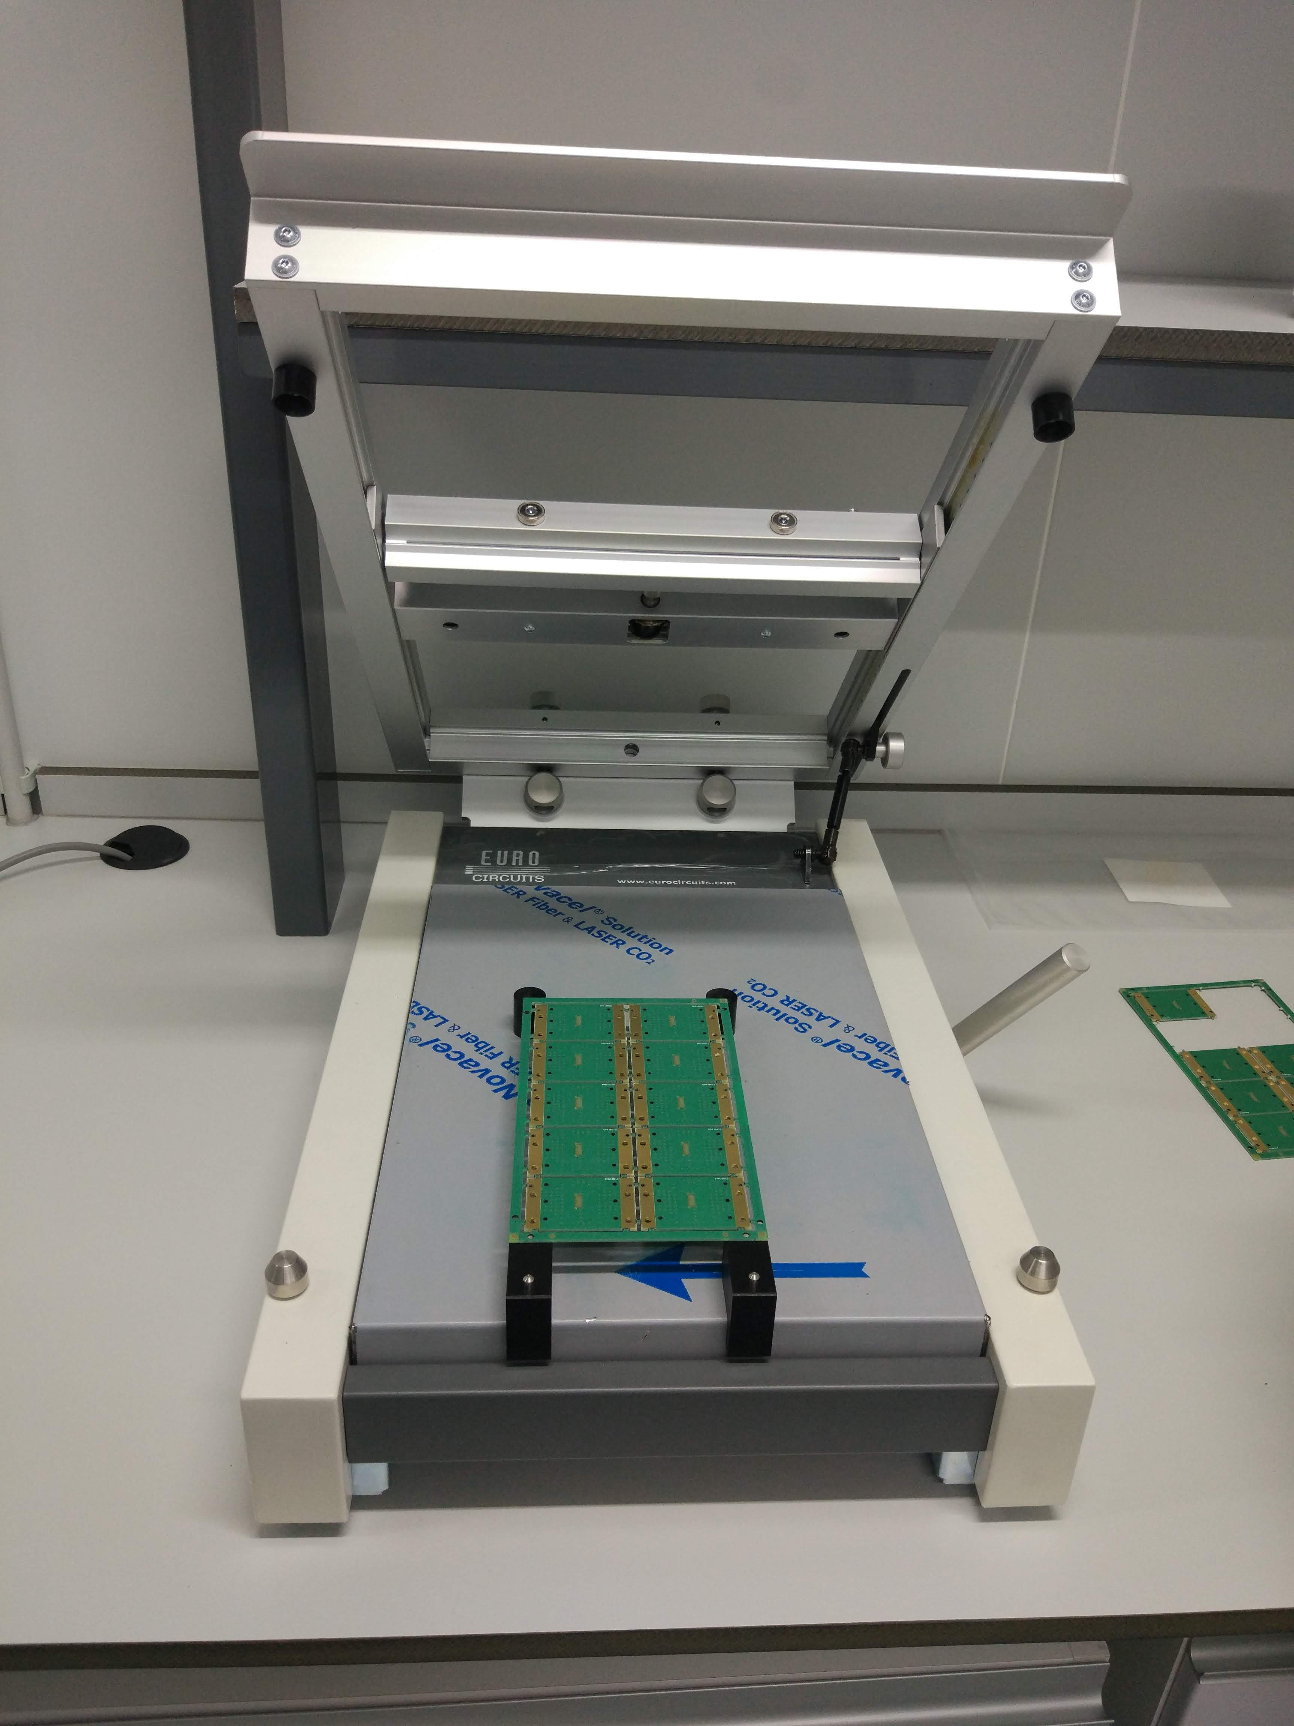
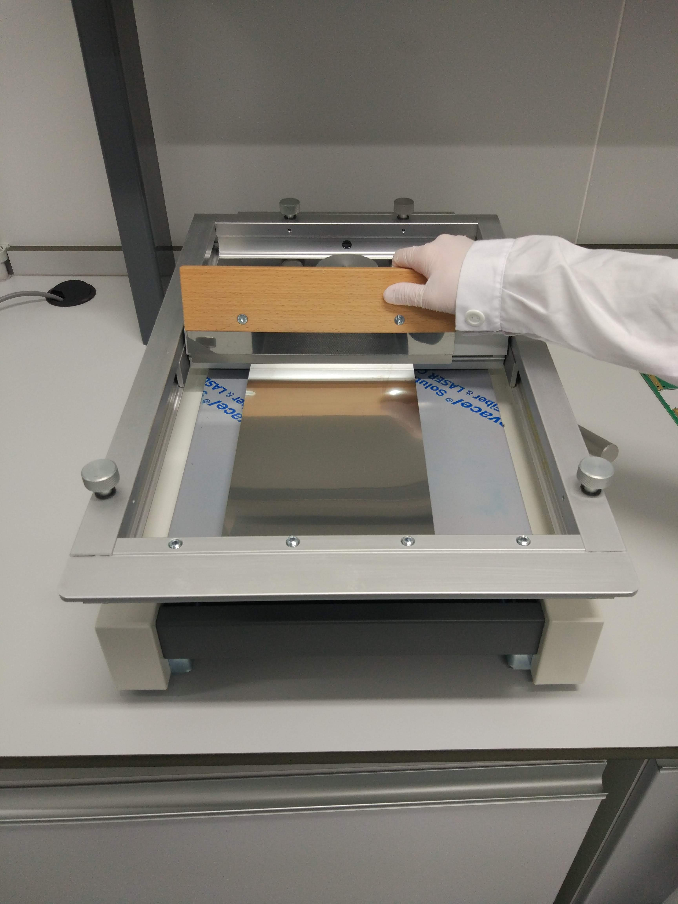
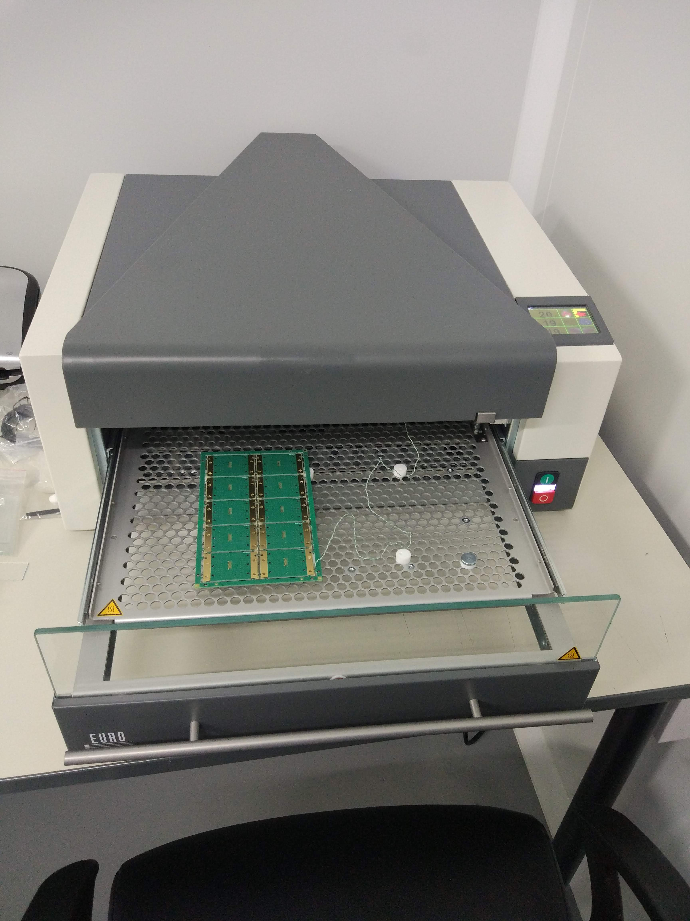
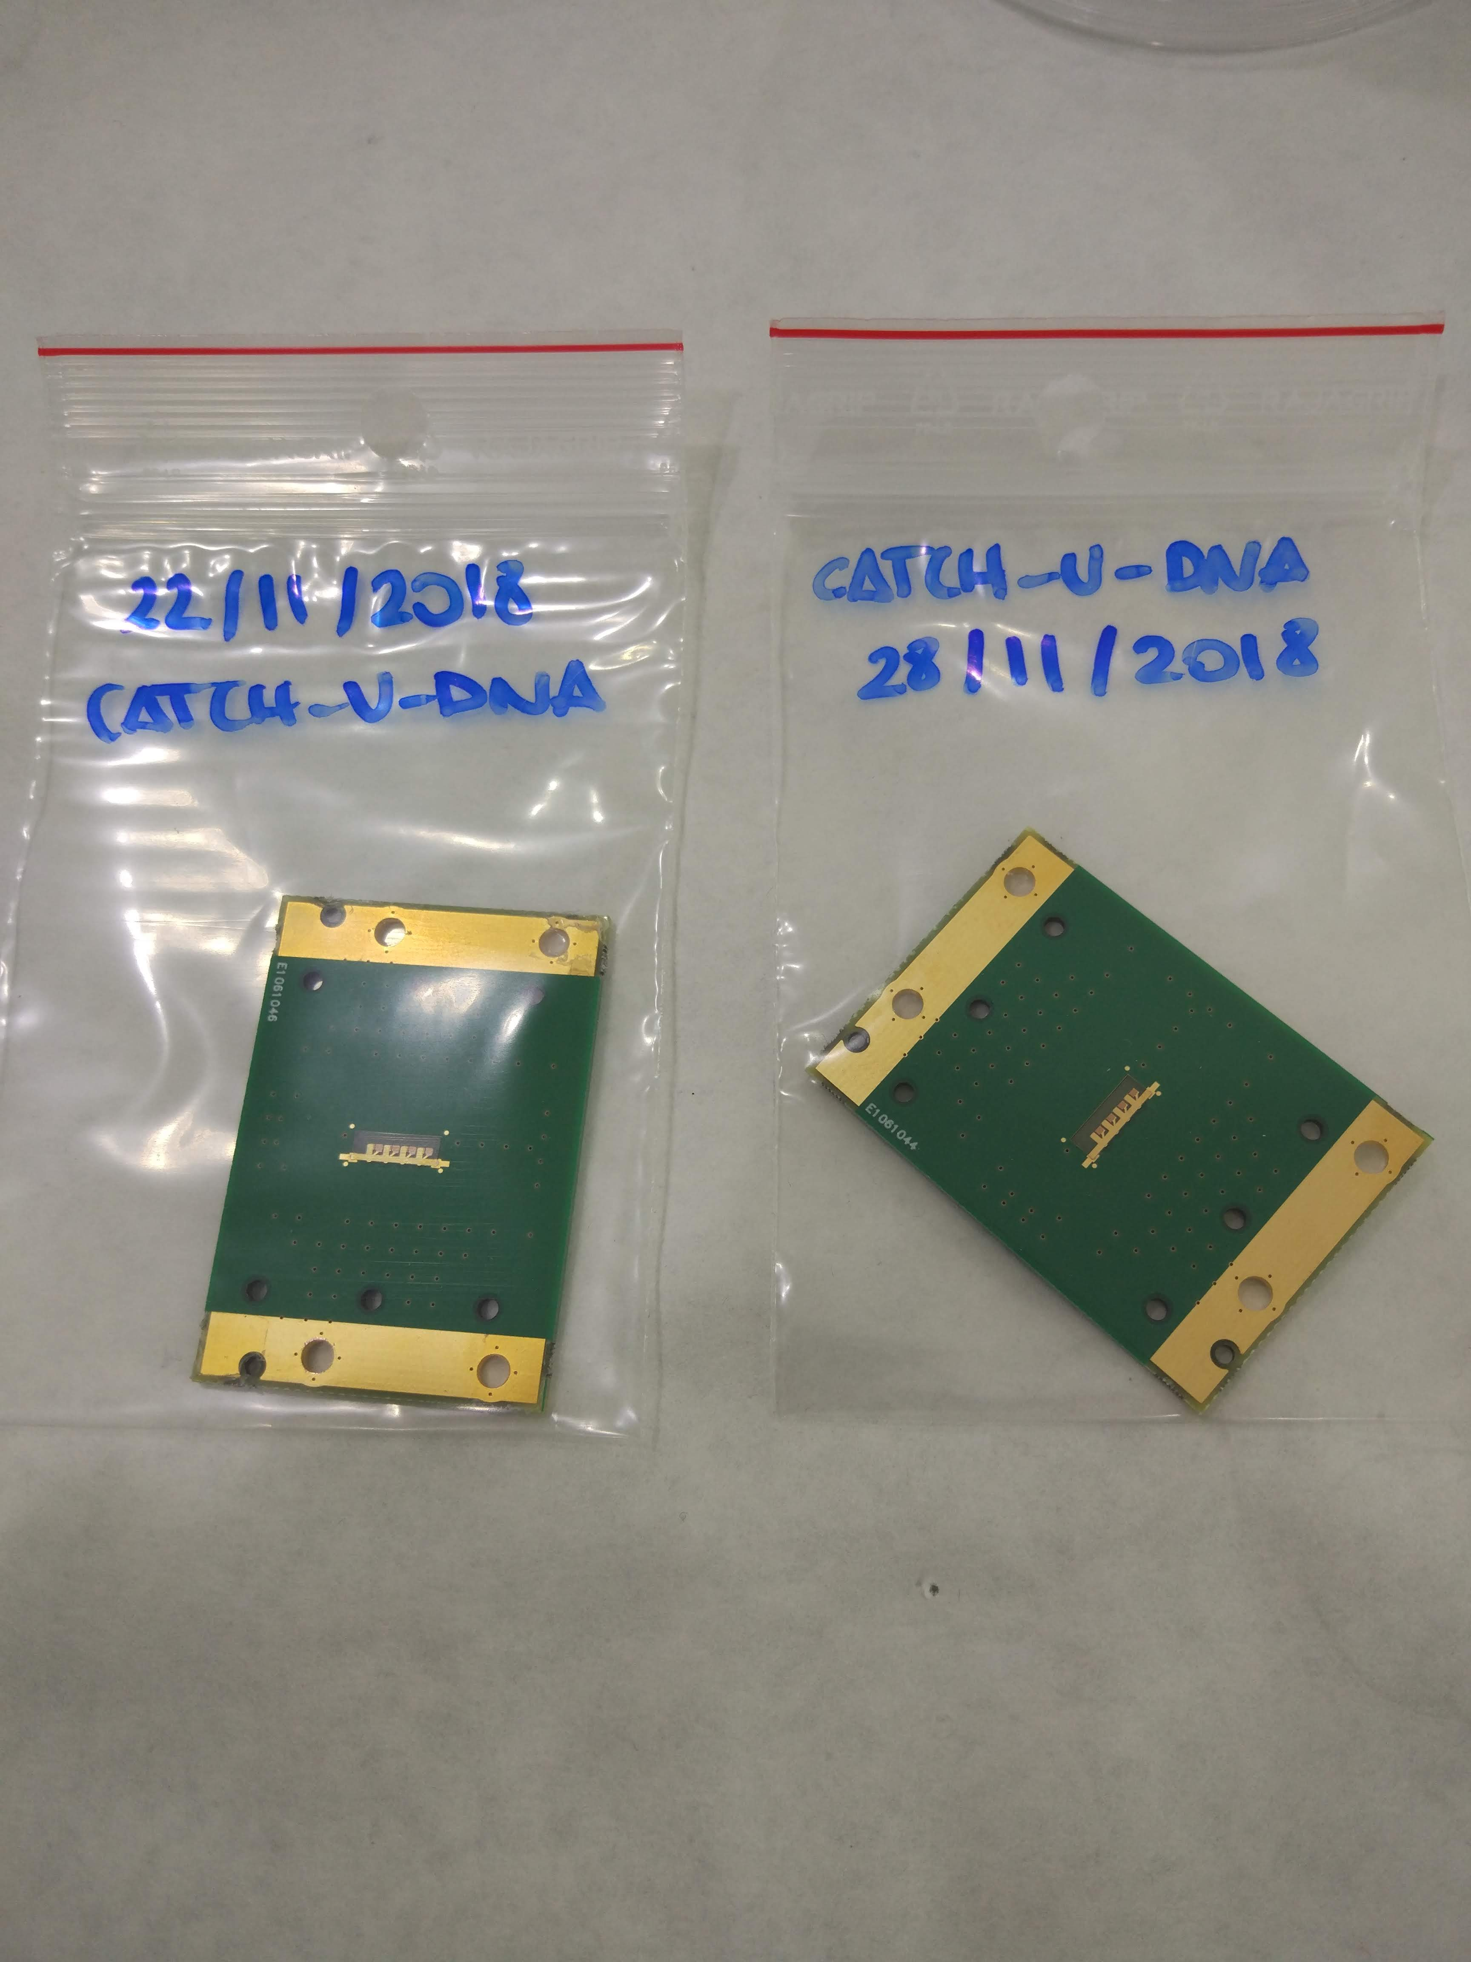
2. Main achievements
4 sensor HFFQCM Array packaging process
Stencil alignment
Epoxy deposition
Curing step
Sensor Assembly

Slide 10
2. Main achievements
4 sensor HFFQCM Array cleaning process
Sensor is submerged in SDS (2%) for 30 minutes
Sensor is thoroughly rinsed with DI water and dried with nitrogen
UV Ozone cleaning (Bioforce) for 30
Sensor is submerged in Ethanol (pure) for 30 minutes
Sensor is dried with nitrogen

Slide 11
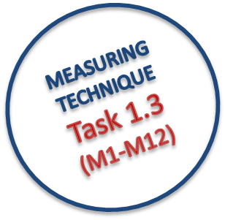
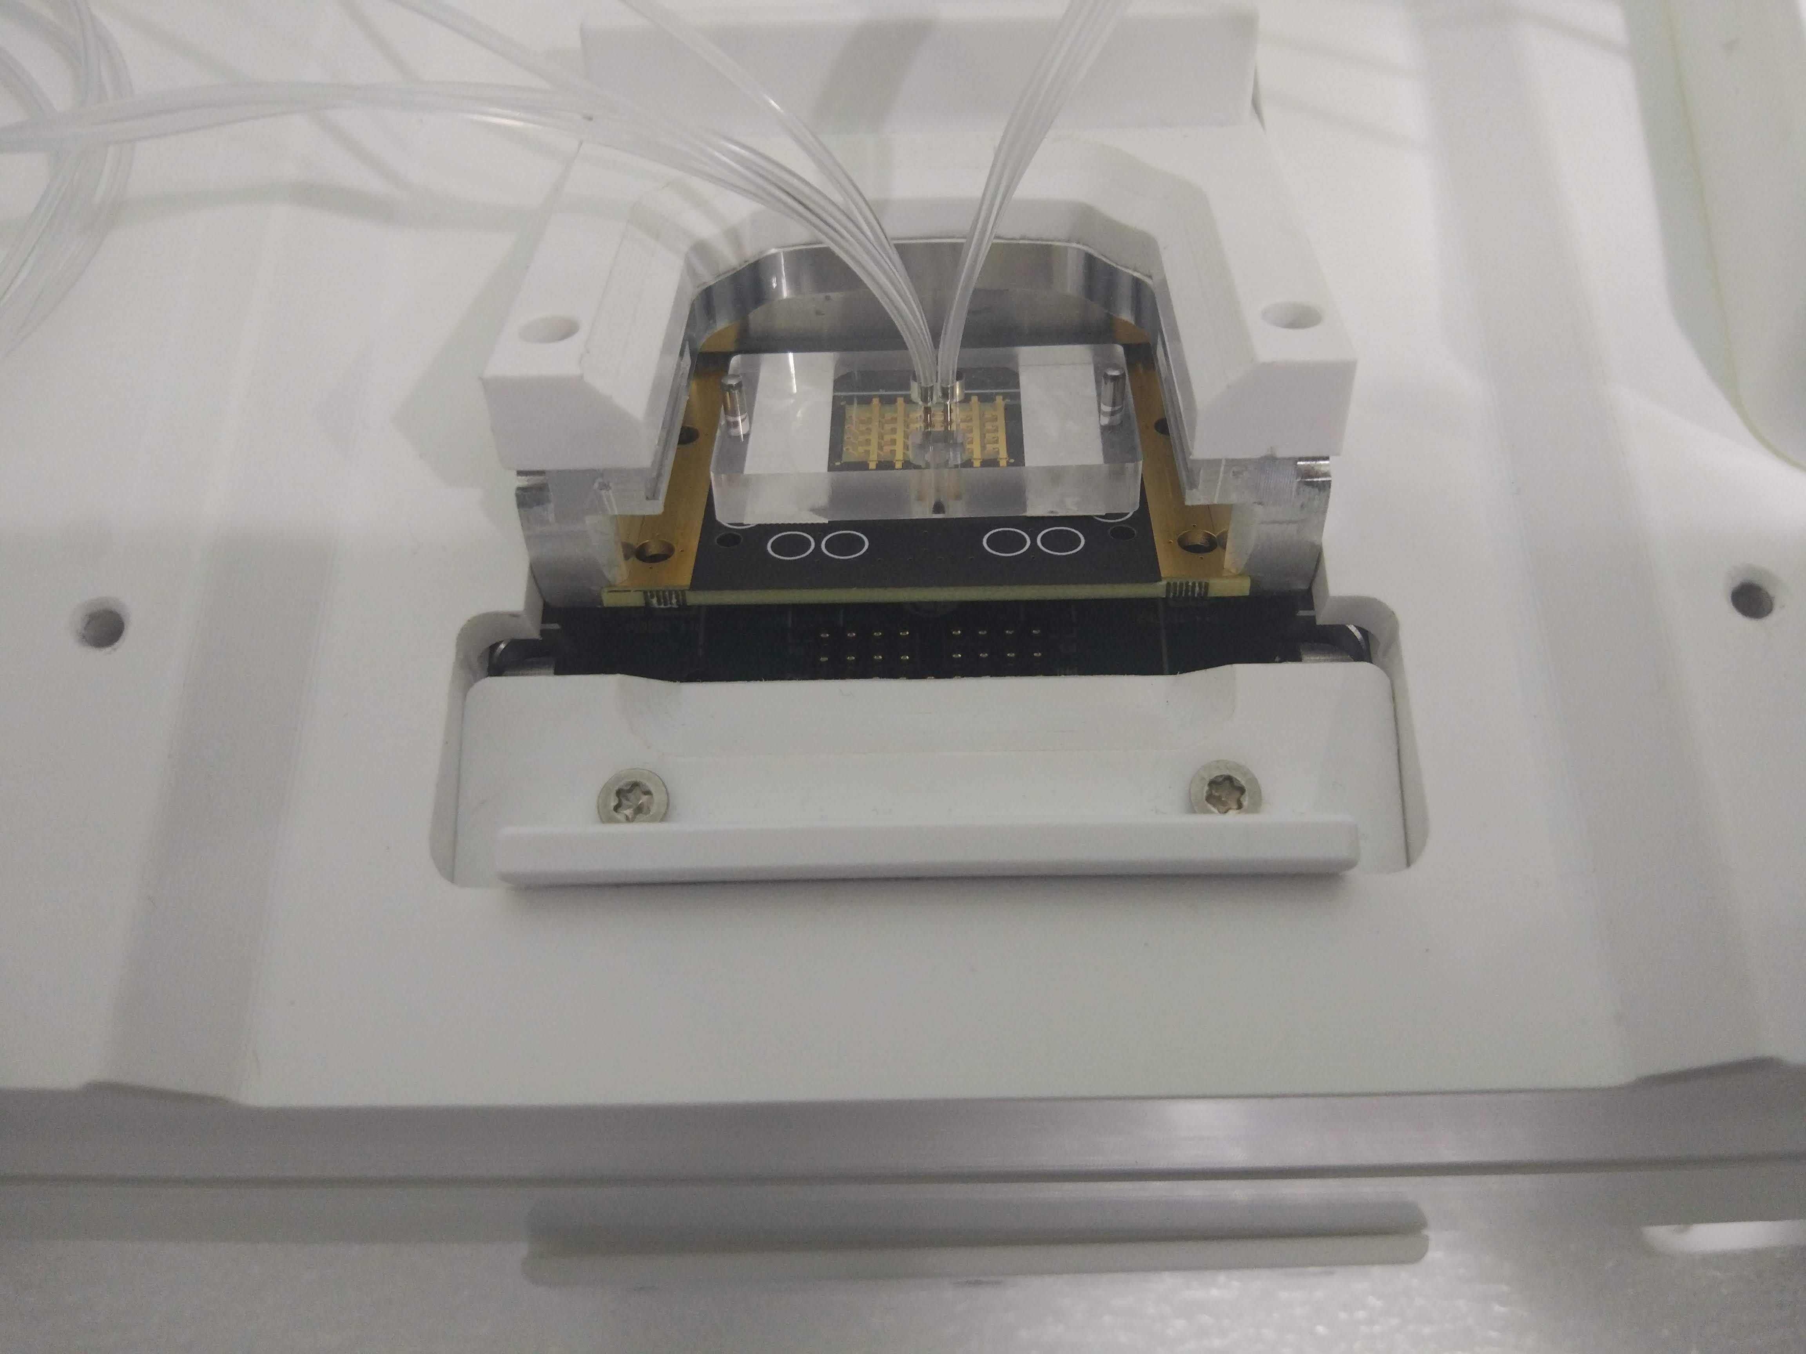
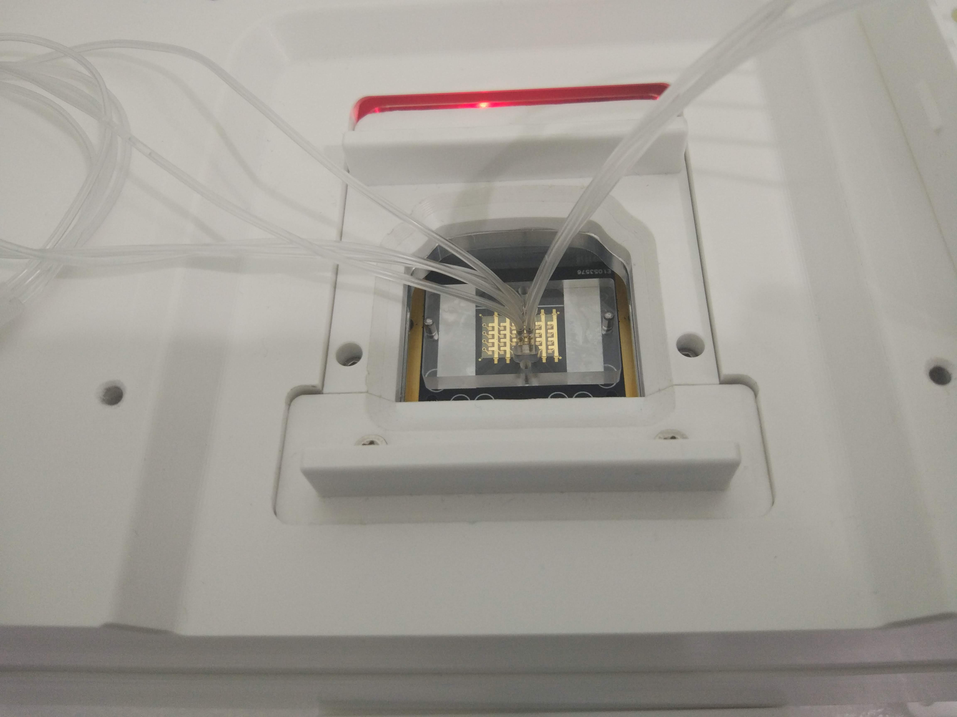
2. Main achievements
Electrical /mechanical interface adaptation for Jobst Flow cell
Preliminary setup (New characterization method not included)

Slide 12
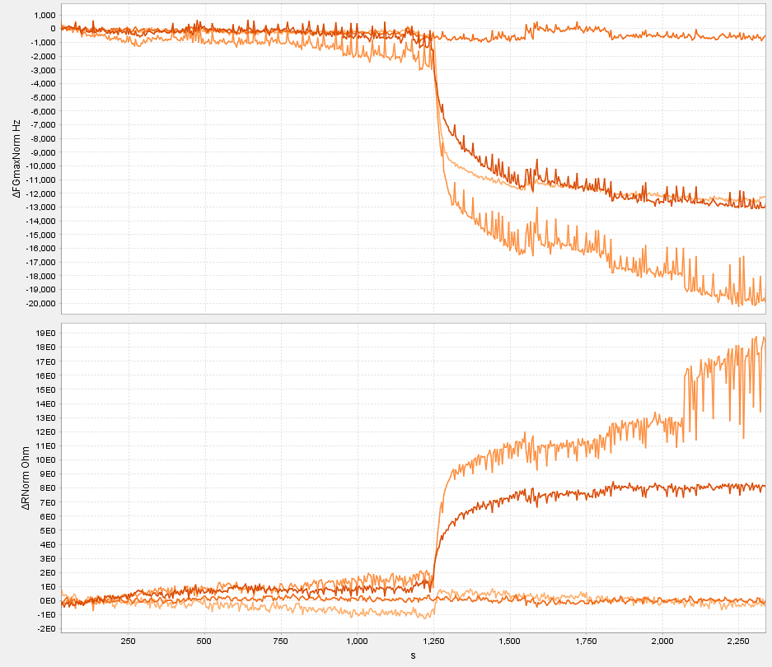
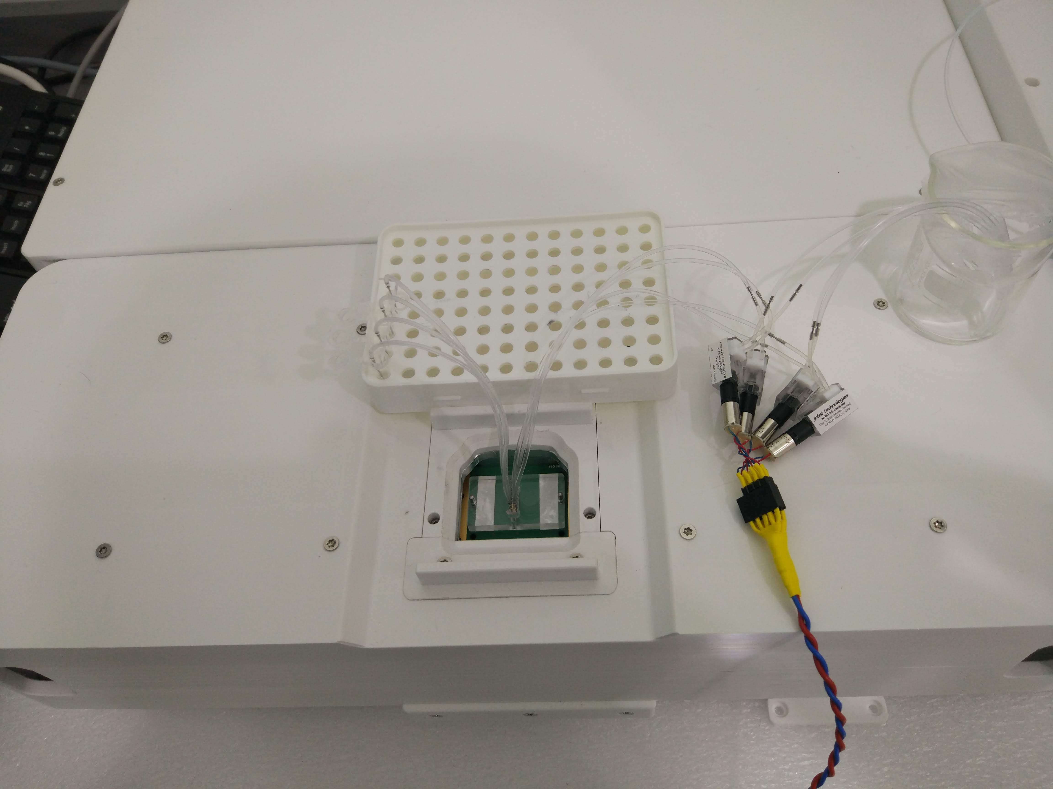
2. Main achievements
Preliminary testing with bio-samples
Streptavidin unspecific adsorption (0.1 mg/ml)
12 ul/min flow rate
Temperature 25.5 ºC
PBS buffer
D 1.2
Preliminary instrument release to FORTH

Slide 13
2. Main achievements
Preliminary testing with bio-samples

Slide 14
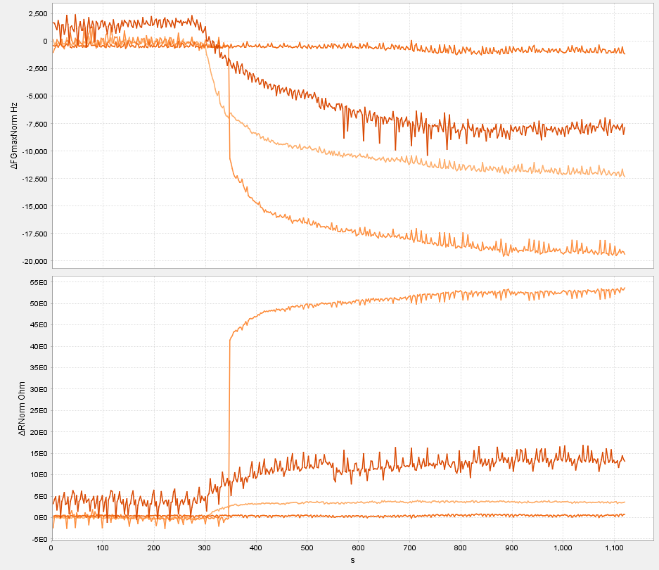
2. Main achievements
Preliminary testing with bio-samples

Slide 15
2. Main achievements
Novel characterization method
Why?
Objective: Measure multiple sensor response simultaneously
Accurate measurement of the acoustic ratio
Calibration issues (complex electronic interface)
High stability/Low noise
Wide operation range (Liposomes)
Characteristics & Benefits
Mixed (Tracking- Fixed frequency) characterization algorithm
Fast (Multiplexing)
Accurate
Wide operation range
Electrical artifacts considered
Patent evaluation

Slide 16
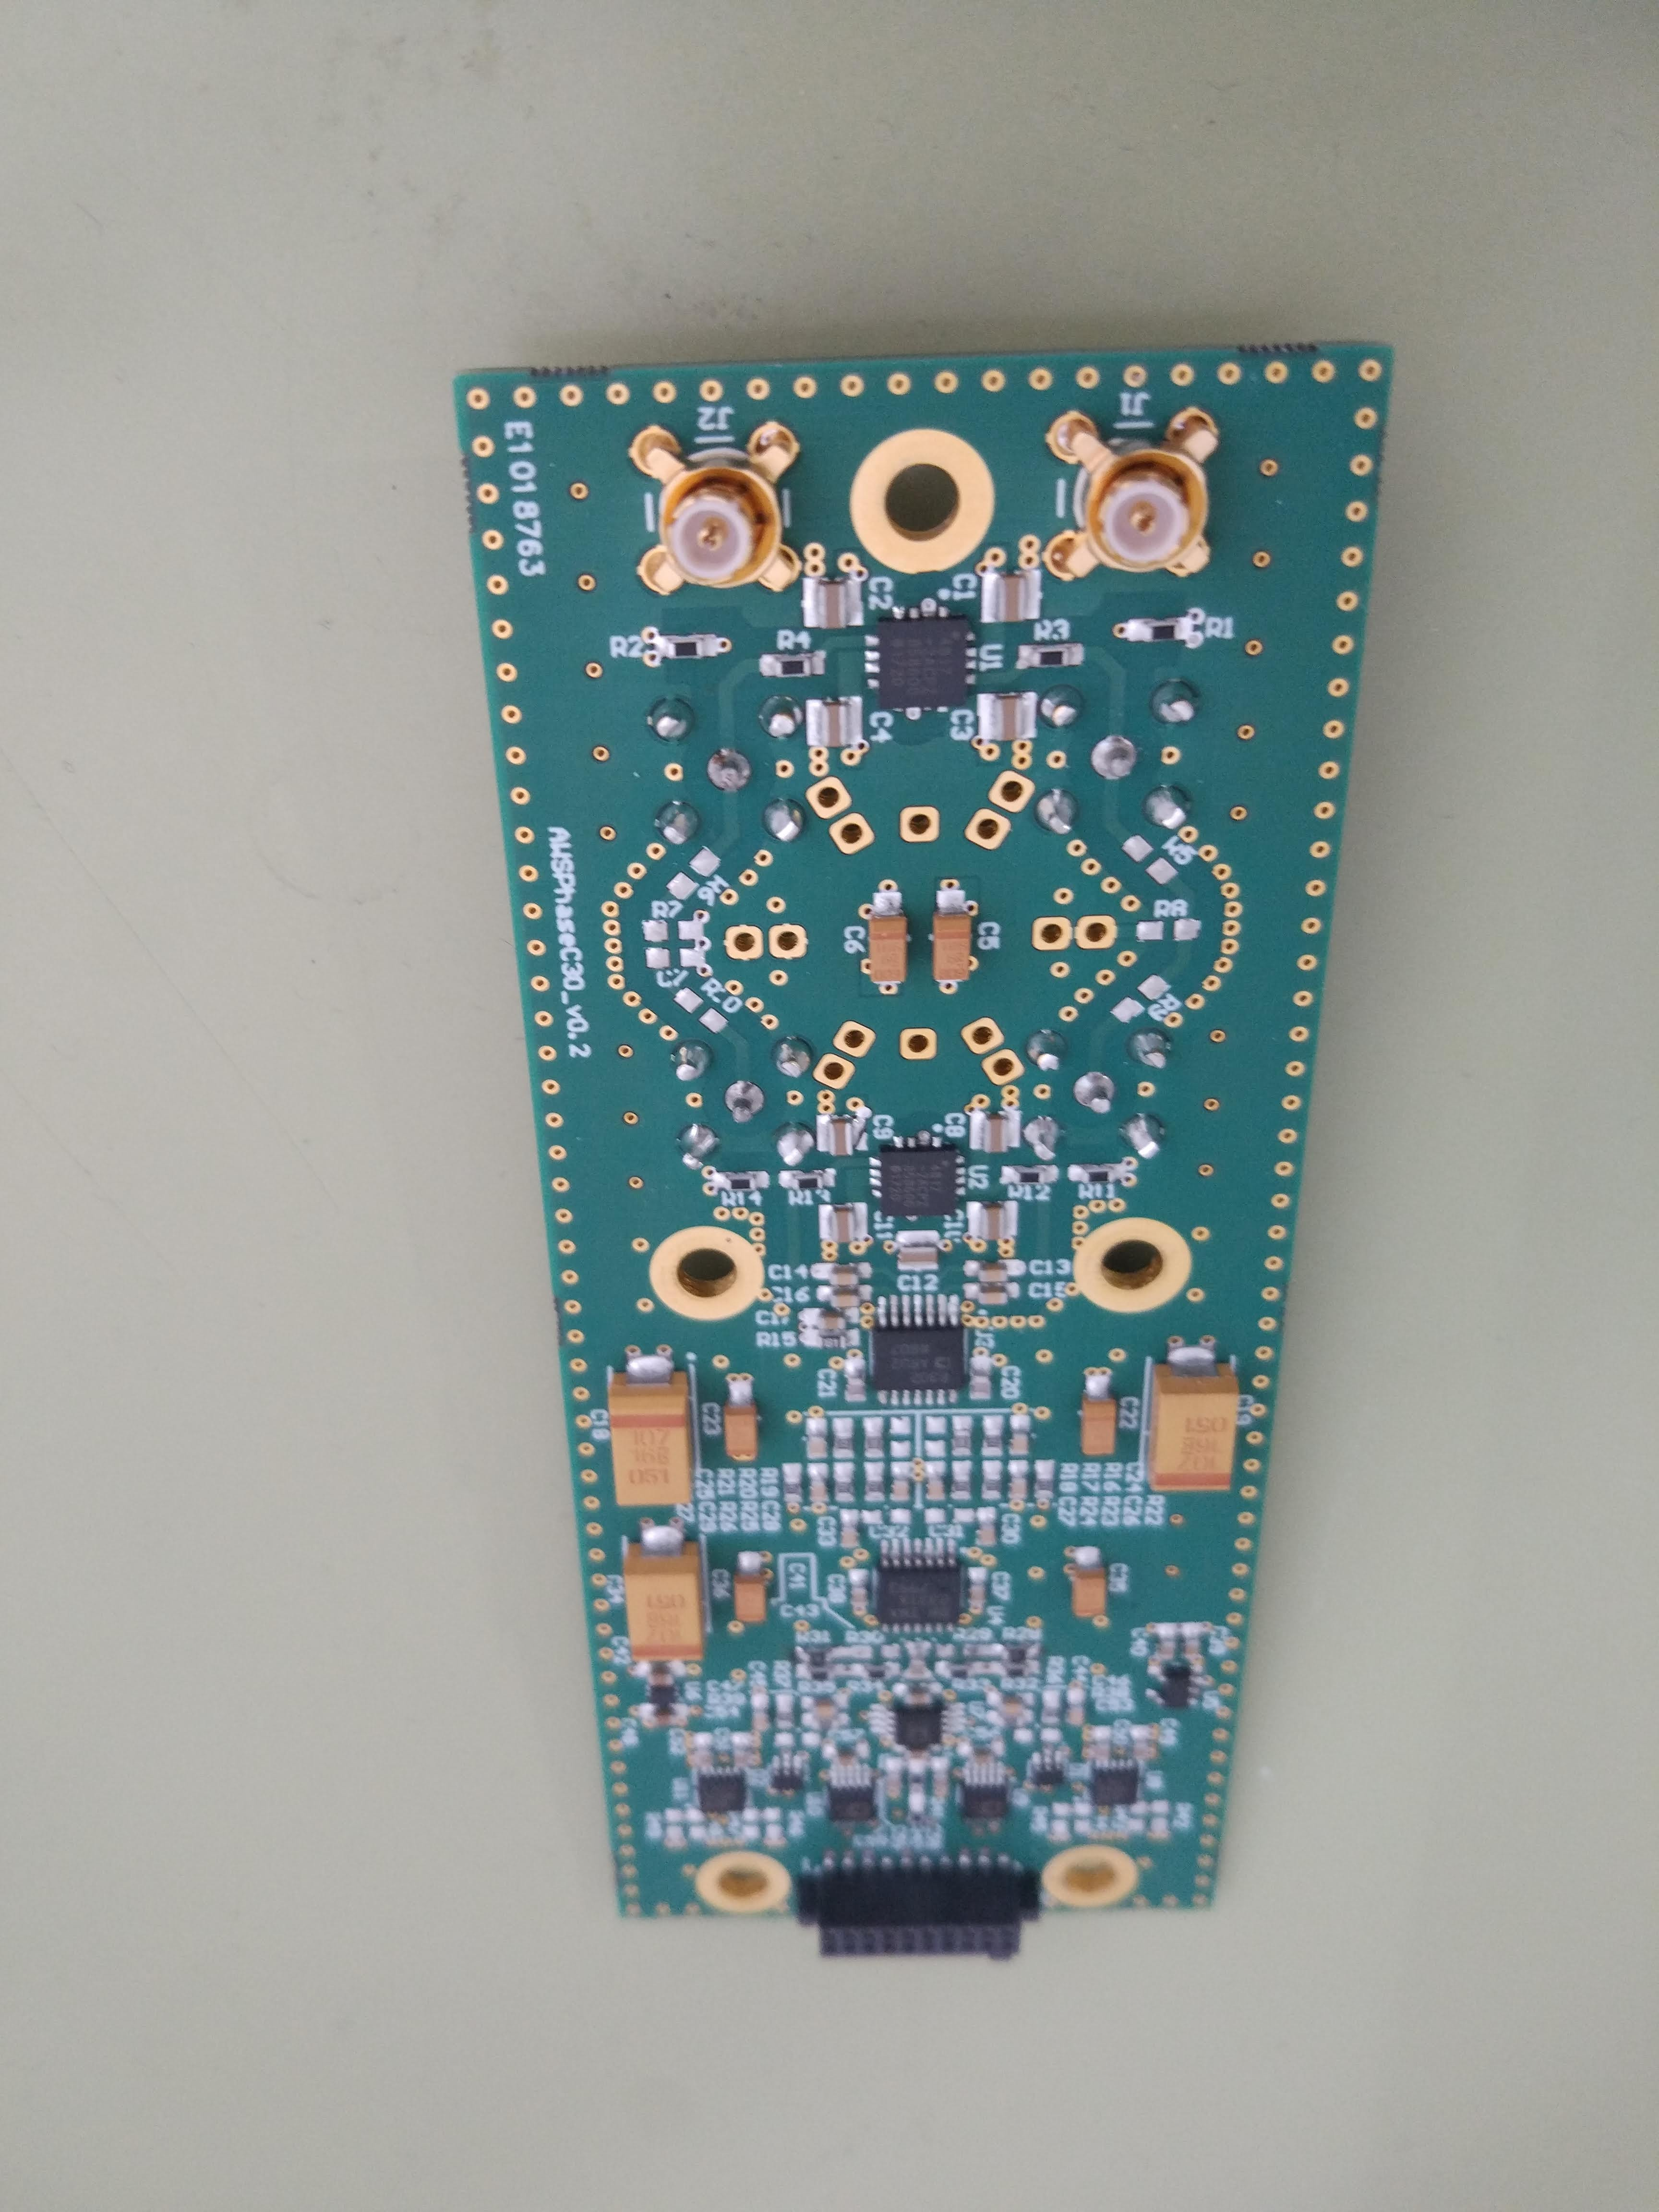
2. Main achievements
Novel characterization method
Implementation
AWSPhase board
Analog differential measurement interface
Analog to Digital converters
Digital acquisition bus

Slide 17
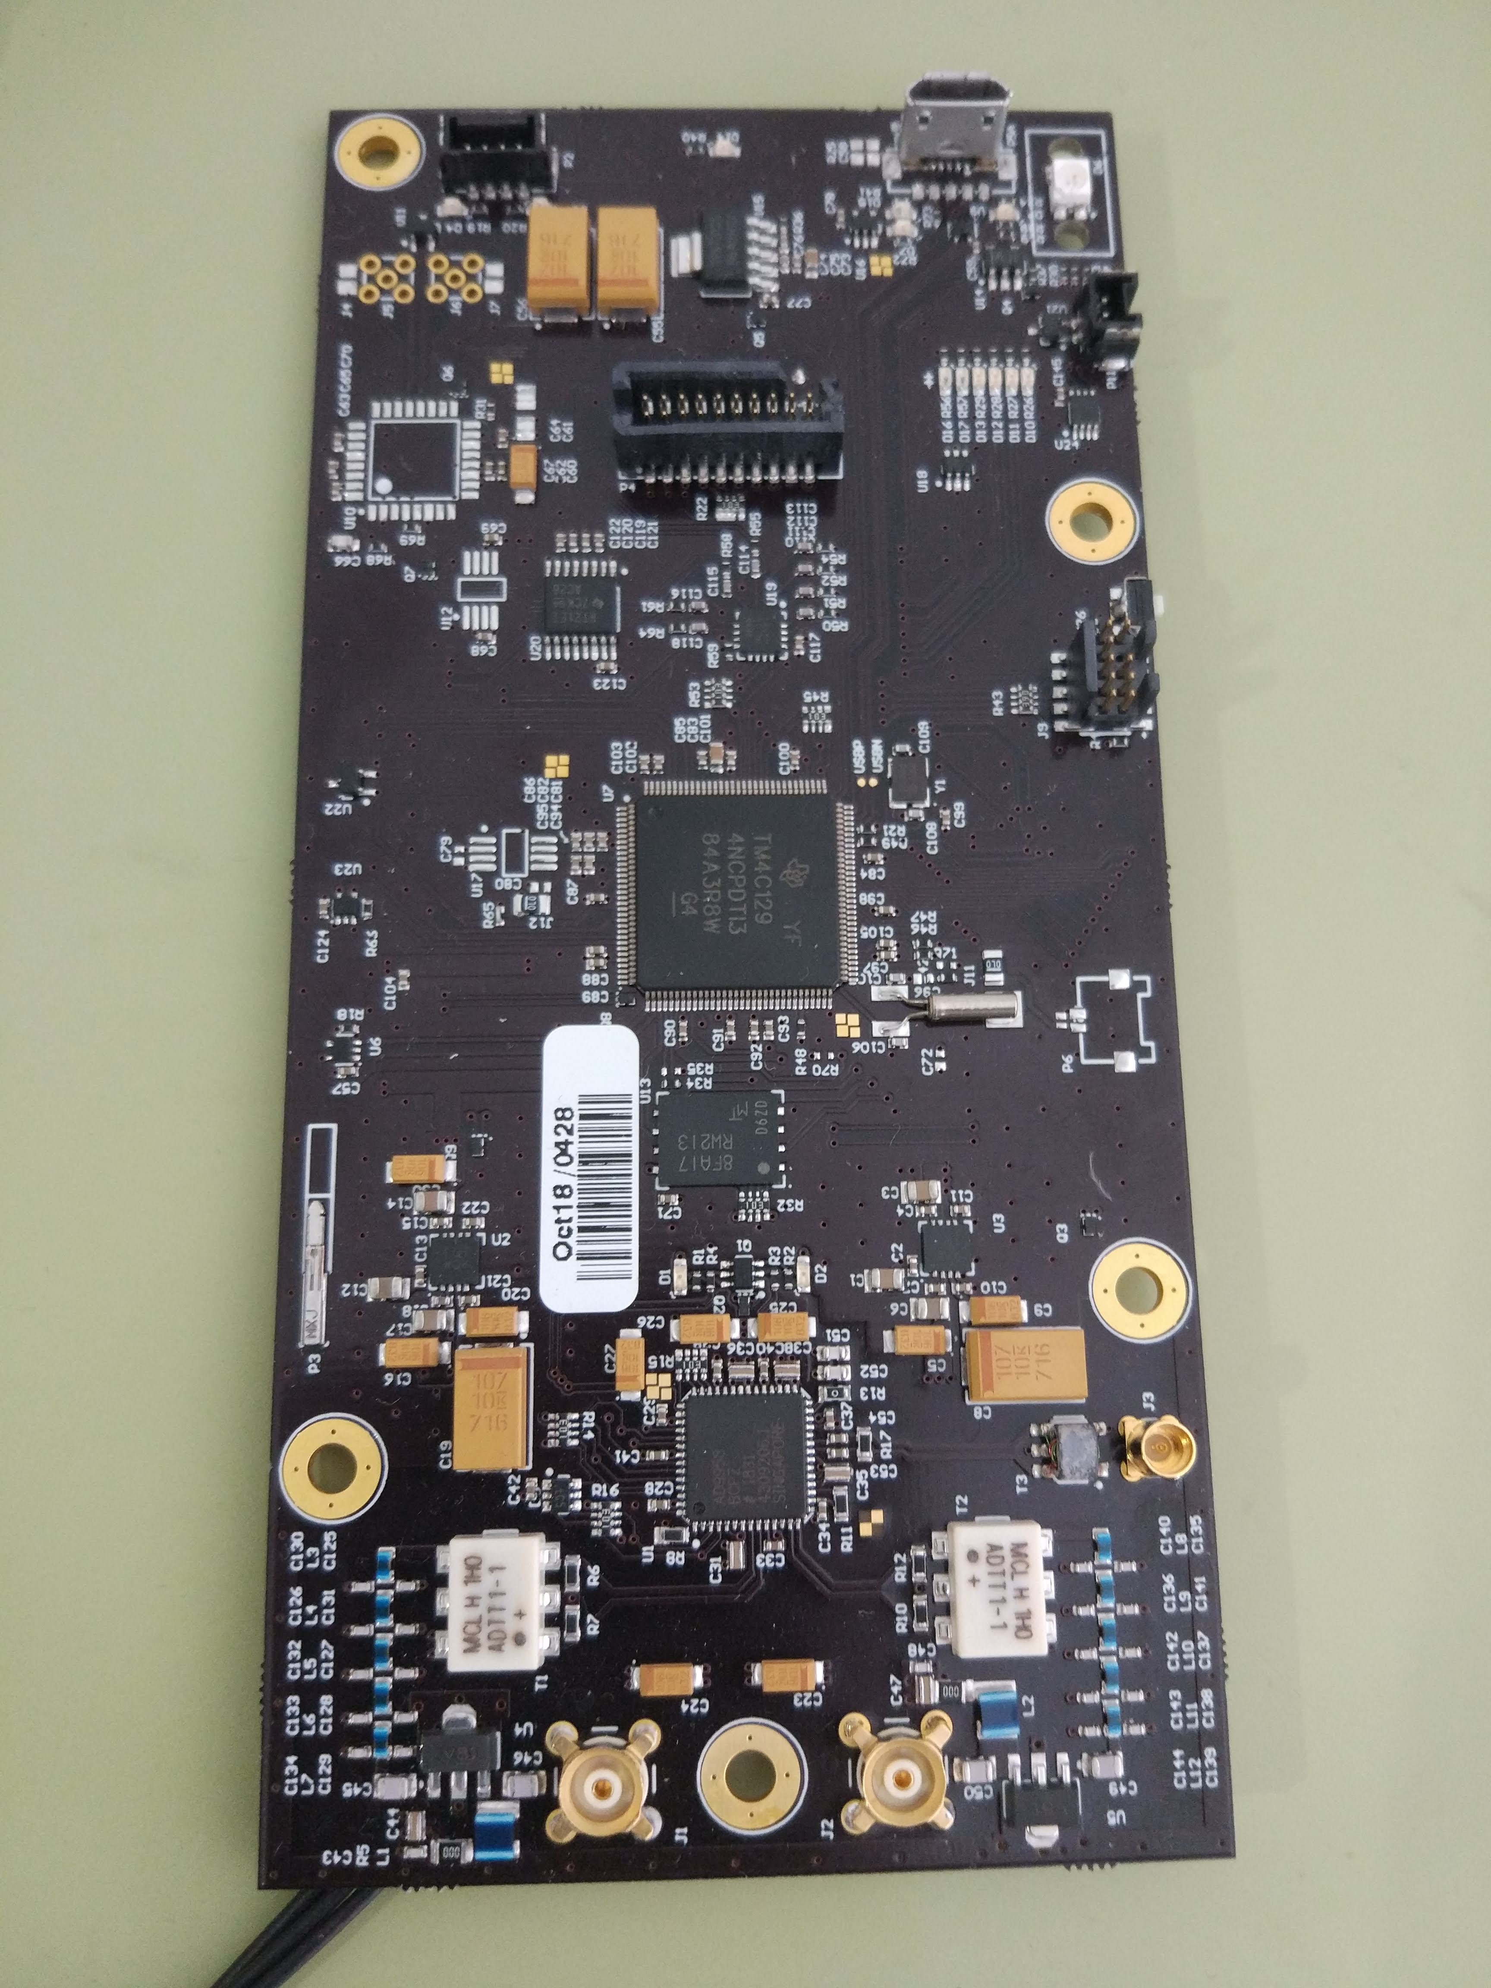
2. Main achievements
Novel characterization method
Implementation
AWSBase board
DDS Signal generation
Microcontroller. Real-time operation
Digital acquisition bus
USB, Bluetooth, Wifi connectivity

Slide 18
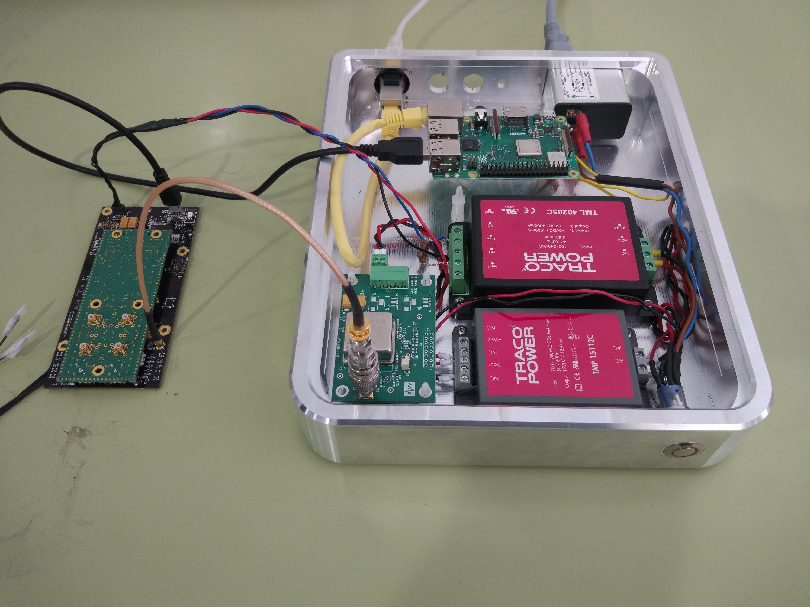
2. Main achievements
Current state of the Instrument prototype
Linux embedded Control Unit
AWSBase +AWSPhase
Reference Clock PCB

Slide 19
3. Future plans
Design of the final CUDNA array ???
Optimization re-design loops
Implementation of the packaging designed
Sensor surface cleaning protocol
Sensor surface modification
Preliminary testing with bio-samples
Implementation of final CUDNA array ???
Hardware/Firmware implementation of the novel characterization method
Delivering a preliminary instrument prototype to test CUDNA overall concept

Slide 20
3. Future plans
Design of the final CUDNA array ??? 24 sensors???
Optimization re-design loops
D 1.2 (Preliminary testing with bio-samples)
Sensor surface modification
Implementation of final CUDNA assembly
Optimization of the fluidic setup (WP6)
Real Time testing of the novel characterization method
Delivering a preliminary instrument prototype to test CUDNA overall concept
Data post-processing algorithms: Common mode rejection (ICA,CAR, Adaptative filtering…)

Slide 21
4. Deviations, delays and problems
No significant problems/delays detected
New timeline proposed to allow re-design loops
Extension of the Task 1.1 to M28. Design of different sensors considering proposals/results of the Consortium
Extension of the Task 1.2 to M30. Implementation of different sensors according to the designs proposed in Task 1.1
Extension of the Task 1.3 to M24 (D1.3 to de delivered in M24)

Slide 22
4. Deviations, delays and problems
Delay in D1.2
Extension of the Task 1.1 to M28. Design of different sensors considering proposals/results of the Consortium
Extension of the Task 1.2 to M30. Implementation of different sensors according to the designs proposed in Task 1.1
Extension of the Task 1.3 to M24 (D1.3 to de delivered in M24)

Slide 23
5. Questions
Thank you!

